Slide 1

BRIGHT COFFEE SHOP
SALES ANALYSIS FOR THE NEW CEO

Slide 2
COTENT
PROJECT OVERVIEW.....01
OBJECTIVES…..02
DATASET OVERVIEW…..03
METHODOLOGY…..04
DATA PROCESSING…..05
REVENUE ANALYSIS…..06
PRODUCT PERFORMANCE…..07
TIME-BASED ANALYSIS…..08
STORES PERFORMANCES…..09
KEY INSIGHTS…..10
RECOMMENDATIONS…..11
FUTURE IMPROVEMENTS…..12
CONCLUTION…..13

Slide 3
01. PROJECT OVERVIEW
This project analyzes coffee shop sales data to identify key trends in revenue, product performance, and customer buying patterns.
Using tools like SQL, Databricks, and Excel, the data was processed and transformed into meaningful insights.
The project aims to identify high-performing products, peak sales periods, and differences in store performance. These insights are then used to provide practical recommendations that can help improve revenue, optimize operations, and enhance customer satisfaction.
The goal is to support better business decisions and improve overall performance.

Slide 4
02. OBJECTIVES
Identify top-performing products and categories
1
Analyze total revenue and sales trends
2
Determine peak sales times and customer patterns
3
Compare performance across store locations
4
Provide data-driven recommendations to improve business performance
5

Slide 5
03. DATASET OVERVIEW
The dataset contains transactional sales data from a coffee shop.
Records from a period of 6 months (Jan – Jun ).
Include 149117 rows.
Key fields :
Store locations
Product category
Transaction time
Transaction Quantity
Unit price
Transaction date
Dataset contains 3 distinct store locations,
9 Product category
A sum of R 698,812.33 total revenue.

Slide 6
04. METHODOLOGY
Data collected from sales transactions
Data cleaned and formatted for accuracy
Created calculated fields (e.g., total revenue, deal date)
Analyzed data using SQL on Databricks
Built visualizations using Excel

Slide 7
05. DATA PROCESSING
Cleaned and formatted raw data
Fixed data types (prices, dates, quantities)
Created calculated field: Total Sales = Unit Price × Quantity
Extracted time features (hour, day)
Grouped data into time buckets (morning, afternoon, evening)

Slide 8
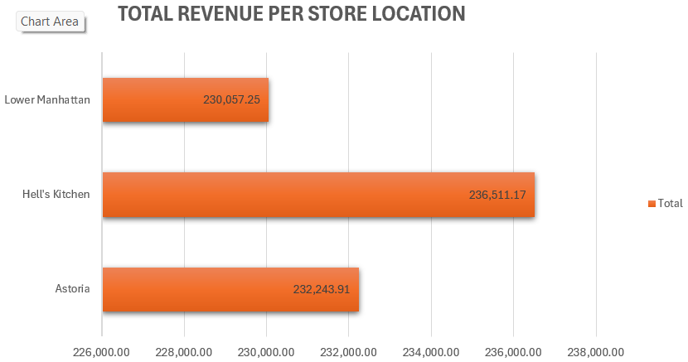
06. REVENUE ANALYSIS
Hell’s Kitchen is generating the most revenue, followed by Astoria and lastly Lower Manhattan.
Total revenue from the 3 distinct store is R 698,812.33

Slide 9
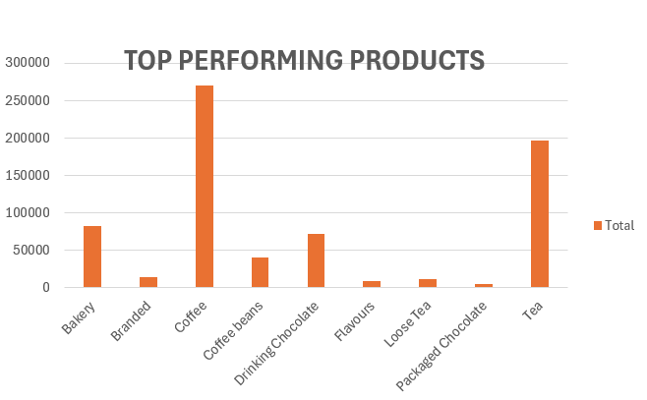
07. PRODUCT PERFORMANCE
Coffee is performing better than all the other 8 product we have in our shops, followed by Tea and Bakery.
Packaged Chocolate is the least performing in our distinct stores followed by Flavours and Loose Tea.
Average performing products are Drinking Chocolate, Coffee Beans and Branded.

Slide 10
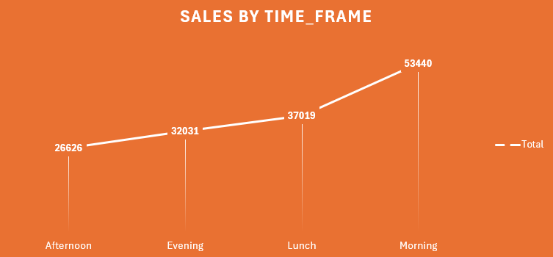
08. TIME-BASED ANALYSIS
Most sales are made in the morning as it presents in the line graph,
Second best performing time of the day is during Lunch time,
Average sales are between Lunch time and Evening
Afternoons the sales drops

Slide 11
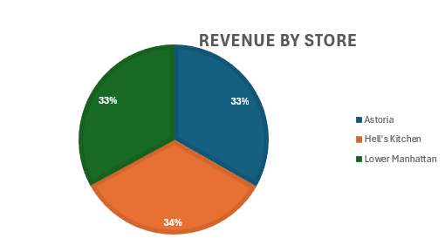
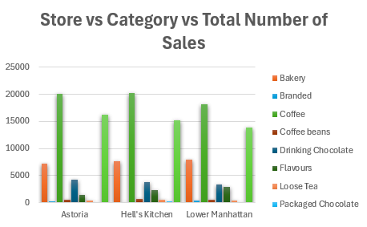
09. STORE PERFORMANCE
Hell’s Kitchen coffee shop perform better than the other stores as it contributes 34% of revenue
Both Astoria and Lower Manhattan contributes 33% of revenue.
The last graph shows the performance of all 3 distinct stores per product category.

Slide 12
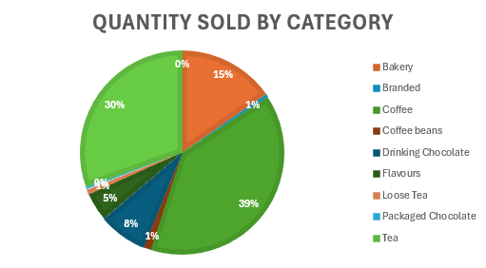
10. KEY INSIGHT
Coffee, Tea & bakery contribute the majority of revenue
Morning hours generate the highest sales
Hell’s kitchen outperform Astoria & Lower Manhattan, as a result more attention should be given to Lower Manhattan as it is the only store with the list sales.
Run promotions on low performing products on the Coffee Shop.

Slide 13
11. RECOMMENDATIONS
Increase stock for for Coffee, Tea & Bakery since they are in demand
Optimize staffing during peak hours
Support low-performing stores with strategy changes
Promotions to improve sales,
Run buy one get one free on poor performing products
Combo deal on off-peak
Peak hours → Morning specials
Slow hours → Happy hour deals
Top products → Combo deals
Low products → Discounts

Slide 14
12. FUTURE IMPROVEMENTS
Automate data processing and reporting using Databricks
01
Develop interactive dashboards (Power BI / Tableau)
02
Implement real-time sales tracking
03
Apply predictive analytics for demand forecasting
04
Expand analysis to include customer behavior and segmentation
05

Slide 15
13. CONCLUSION
In conclusion, this analysis has shown that by focusing on key products, optimizing peak-hour operations, and improving underperforming areas, the business can increase revenue and operate more efficiently. Data-driven decision-making will be essential for sustainable growth

